Slide 1
Unit 4 Foundations of Data Science

Slide 2
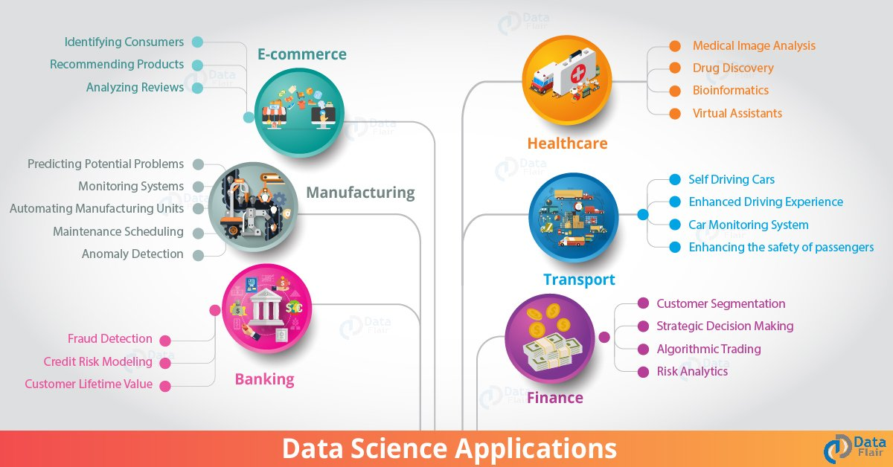
Real World Data Science Applications

Slide 3
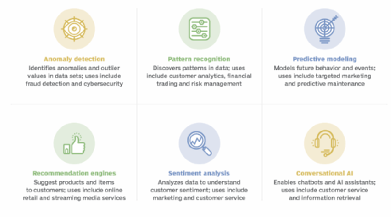
Research-Based Data Science Applications

Slide 4
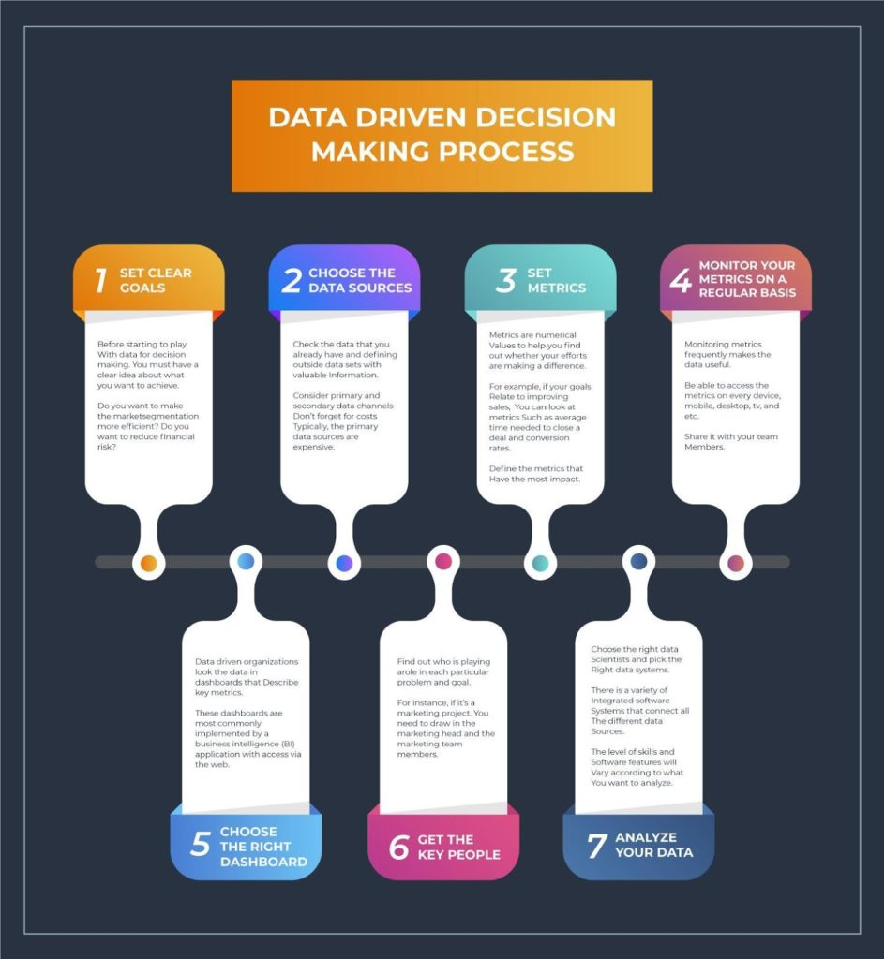
Data Driven Decision Making

Slide 5
Introduction to Machine Learning
The world is getting “smarter” every day, and to keep up with consumer expectations, companies are increasingly using machine learning algorithms to make things easier.
You can see them in use in end-user devices (through face recognition for unlocking smartphones) or for detecting credit card fraud (like triggering alerts for unusual purchases).

Slide 6
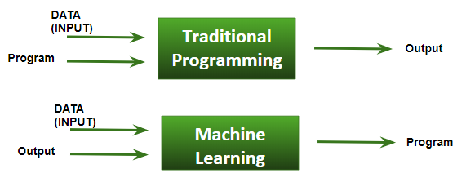
Machine Learning
Machine Learning is defined as “field of study that gives computers the capability to learn without being explicitly programmed”.

Slide 7
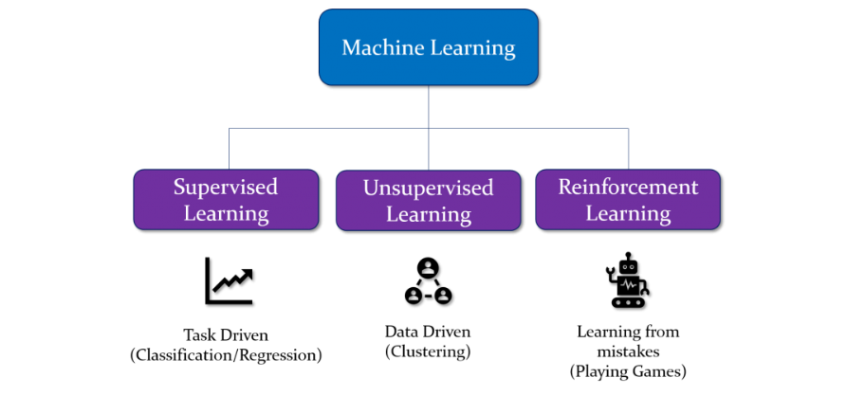
Types of Machine Learning

Slide 8
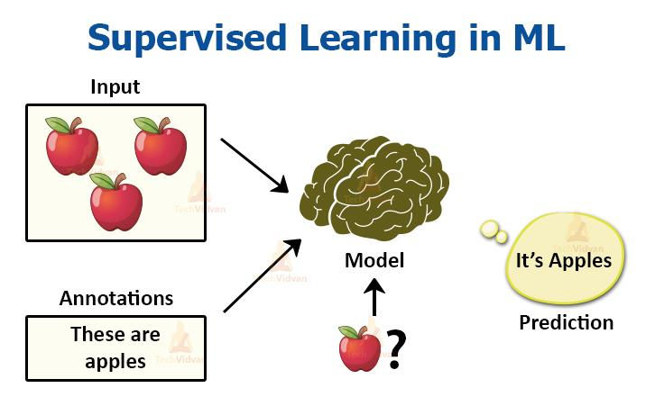
Supervised Machine Learning
Supervised learning is when the model is getting trained on a labelled dataset.
These datasets are designed to train or “supervise” algorithms to classify data or predicting outcomes accurately.
A labelled dataset has both input and output parameters.
Using labeled inputs and outputs, the model can measure its accuracy and learn over time.
In this type of learning both training and validation, datasets are labelled.
Supervised learning can be separated into two types of problems when data mining:
Classification
Regression

Slide 9
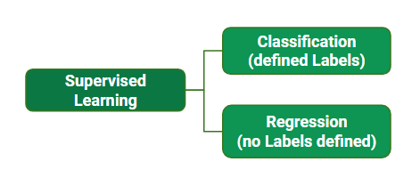
Types of Supervised Machine Learning

Slide 10
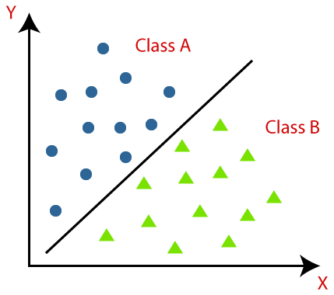
Classification
The Classification algorithm is a Supervised Learning technique that is used to identify the category of new observations on the basis of training data.
In Classification, a program learns from the given dataset or observations and then classifies new observation into a number of classes or groups.

Slide 11
Classification
Classification problems use an algorithm to accurately assign test data into specific categories, such as separating apples from oranges.
Or, in the real world, supervised learning algorithms can be used to classify spam in a separate folder from your inbox.
Linear classifiers, support vector machines, decision trees and random forest are all common types of classification algorithms.

Slide 12
Classification
from sklearn.neighbors import KNeighborsClassifier
from sklearn.model_selection import train_test_split
from sklearn.datasets import load_iris
# Loading data
irisData = load_iris()
# Create feature and target arrays
X = irisData.data
y = irisData.target
# Split into training and test set
X_train, X_test, y_train, y_test = train_test_split(
X, y, test_size = 0.2, random_state=42)
knn = KNeighborsClassifier(n_neighbors=7)
knn.fit(X_train, y_train)
# Calculate the accuracy of the model Output:
0.9666666666666667
print(knn.score(X_test, y_test))

